Slide 1

Project of Artificial Intelligence for Deaf and Aphonic
MINI PROJECT
PRESENTED BY:
BATCH C1:
T. HEMANTH (205U1A05D2)
P. PUJITHA (215U5A0527)
G. RANJITH KUMAR (215U5A0512)
M.YAMINI (215U5A0522)
GUIDE:
Dr. SHAIK ABDUL NABI
VICE PRINCIPLE & HOD

Slide 2

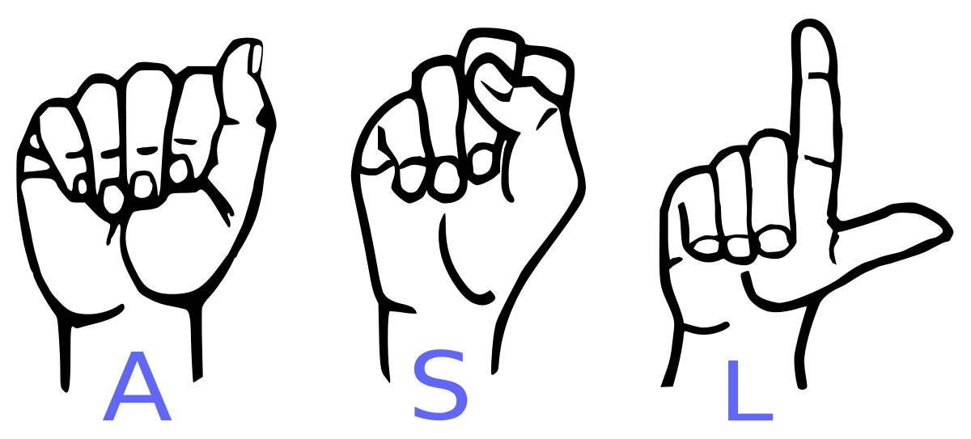
Project of Artificial intelligence for Deaf and Aphonic
Text or audio convert into sign language

Slide 3

Abstract
Our project aims to create a computer application and train a model which shown a real time video of hand gestures of American Sign Language the output. For the particular sign in text format or the Audio format from the screen.

Slide 4

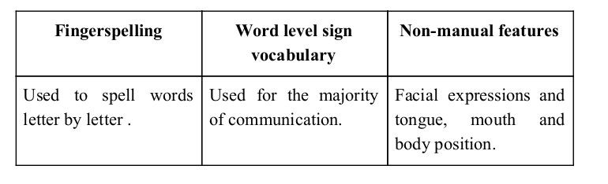
Sign language is a visual language and consists of 3 major components:

Slide 5
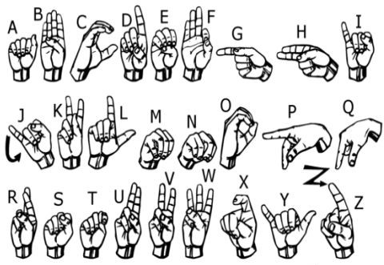
We implemented 26 symbols(A-Z) of ASL in our project.

Slide 6
Existing System
Vision-Based Approach: Utilizes cameras to capture gesture images, extracting key features for recognition. It employs image processing techniques and machine learning to interpret the captured images for speech or text. Advantages include high accuracy and robustness in recognition.
2.Sensor-Based Approach: Involves using various sensors placed on the hand to record data when gestures are performed. Analyzing this data aids in recognition. However, this approach can disrupt natural hand motions due to external hardware use and may have limitations in recognizing complex gestures.

Slide 7
Proposed System
We creating a software application and training a model where the 26 alphabets of ASL are using as the dataset.
Our application can convert into the test format or audio format into the video of hand gestures of sign language and produced the sound also for the respective text.

Slide 8
L i t e r a t u r e S u r v e y

Slide 9
Each sign language has its own unique grammar, vocabulary, and syntax. ASL, BSL, and ISL, for instance, differ significantly from each other. People often don't realize how nuanced and intricate sign languages can be, just like spoken languages.
Utilizing Naïve Bayes Classification within a vision-based sign language recognition system enhances performance by reducing computational time and ensuring real-time responsiveness.
Utilizing appearance-based methods in sign language recognition involves extracting spatial features through 2D-CNNs(conventional neural network) and temporal information via RNNs(recurrent neural network) , often combining hand-crafted features with deep learning models like LSTM (Long short term memory) for effective recognition.

Slide 10
Skeleton-based sign language recognition methods utilize pose estimation, extracting skeletal joint data from images or videos. These methods employ approaches like GRU(Gated Recurrent Unit) and GCN (Graph Convolutional Networks) to extract spatiotemporal information from body, hand, and sometimes face data, enhancing recognition accuracy.
Using multiple modalities such as RGB, depth, optical flow, and skeleton in fusion strategies like early or late fusion significantly enhances recognition accuracies, as seen in winning approaches at ChaLearn-2021. However, these multimodal methods, while effective, often demand substantially more processing power compared to single-input modalities.

Slide 11
Software Requirements
Python 3.6.6
Tensorflow 1.11.0
OpenCV 3.4.3.18
NumPy 1.15.3
Matplotlib 3.0.0
CUDA 12.2 (GUI)
Keras 2.2.1
PIL 5.3.0
Tkinter

Slide 12
Hardware Requirements
At least i3 processor
8GB RAM
4GB Graphic card
At least 255 SSD
Good Camera support
Good Microphone Support

Slide 13
Methodology

Slide 14
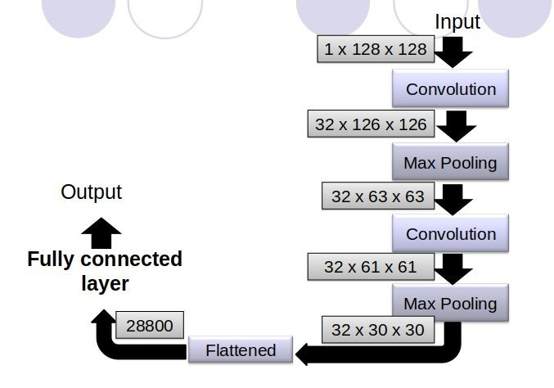
SKELETON OF THE MODEL

Slide 15
UML Diagrams

Slide 16
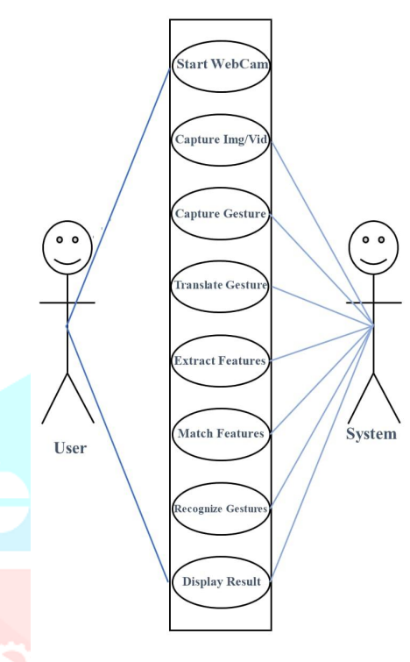
USECASE DIAGRAM – Sign To Voice Conversion

Slide 17
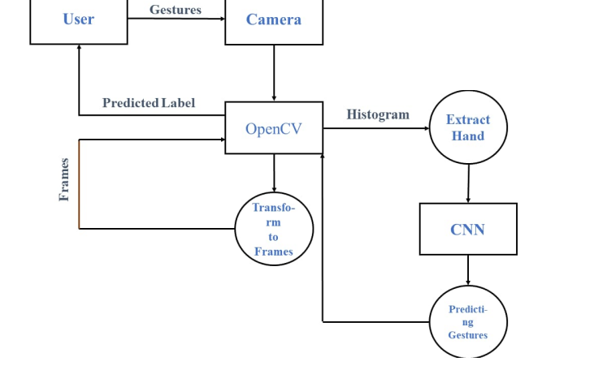
DATA FLOW DIAGRAM– Sign To Voice Conversion

Slide 18
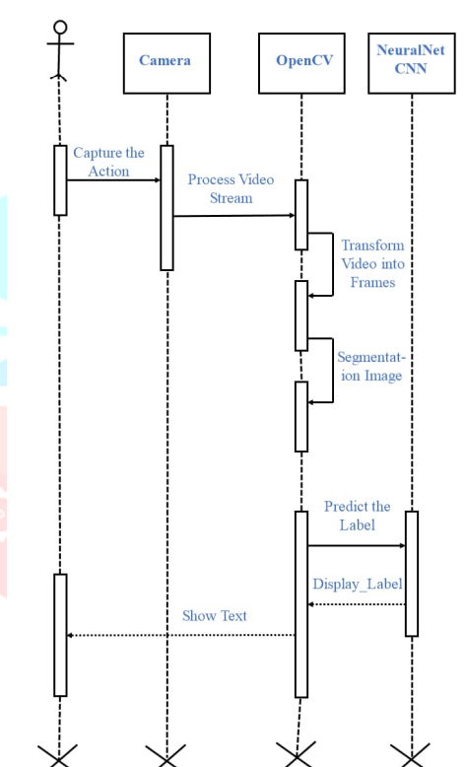
SEQUENCE DIAGRAM– Sign To Voice Conversion

Slide 19
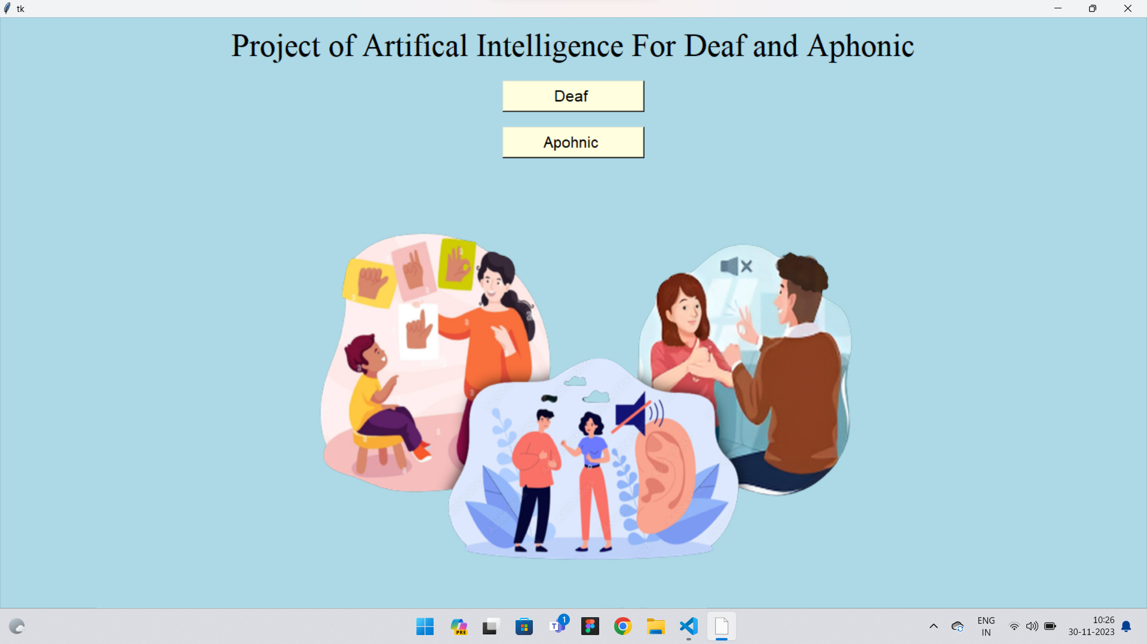

Slide 20
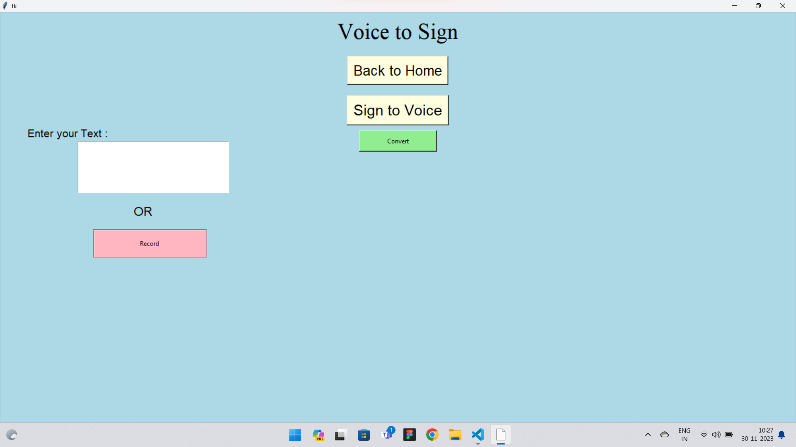

Slide 21
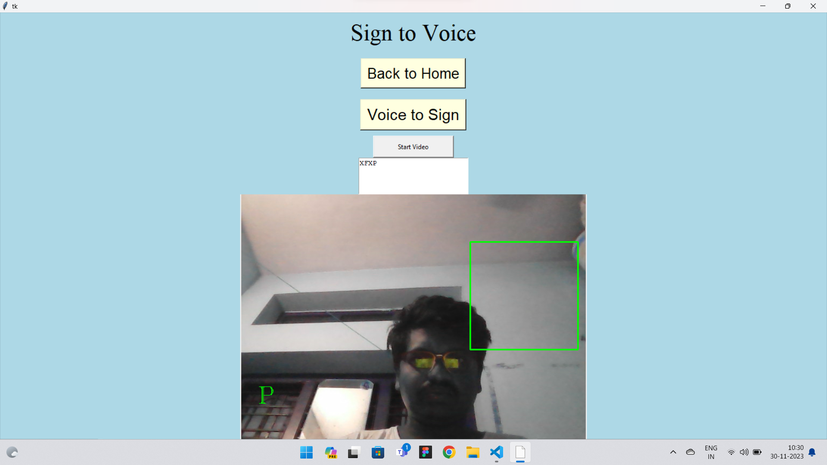

Slide 22
Implementation
.
Input Processing: Text or image input is received via the keyboard, undergoes pre-processing steps such as grayscale convergence, edge detection, and conversion into an array of images.
Pattern Recognition and Matching: Parameters extracted from the input text or image are compared with the database, focusing on pattern recognition to identify matches.
Output Generation: Depending on the input type (text or sign language image), the system produces corresponding outputs - text for sign language input and sign language images for textual input.
Database Significance: The accuracy and effectiveness of the system's output heavily rely on the database, housing images of alphabets and words necessary for translation.
Matching and Translation Process: Features are extracted from the input text, matched with stored database features, and upon successful matching, the accurate result is displayed on the output screen, be it in text or sign language form

Slide 23
Challenges Faced
We couldn’t find a dataset with raw images of all the asl characters so we made our own dataset.
Second issue was to select a filter for feature extraction. We tried various filter including binary threshold, canny edge detection, gaussian blur etc. ,of which gaussian blur filter was giving better results.
Issues were faced relating to the accuracy of the model we trained in earlier phases which we eventually improved by increasing the input image size and also by improving the dataset.

Slide 24
Limitations of our model
The model works well only in good lighting conditions.
Plain background is needed for the model to detect with accuracy.

Slide 25
Conclusion
In this report, a functional real time vision based american sign language recognition for Deaf and Aphonic people have been developed for asl alphabets.
We achieved an accuracy of 98.00% on our dataset.

Slide 26
Future Scope
We are planning to achieve higher accuracy even in case of complex backgrounds by trying out various background subtraction algorithms.
We are also thinking of improving the preprocessing to predict gestures in low light conditions with a higher accuracy.
Prediction has been improved after implementing two layers of algorithms in which we verify and predict symbols which are more similar to each other.

Slide 27
Reference
Article Artificial Intelligence Technologies for Sign Language Ilias Papastratis , Christos Chatzikonstantinous , Dimitrios Konstantinidis, Kosmas Dimitropoulos and Petros Daras sensors 2021 .
International Journal For Technological Research In Engineering Volume 7, Issue 12, August-2020
Sign Language Recognition By Image Processing 1Sabari Priya A, 2Adrija Nair, 3Sreejin Madhavan, 4Kavitha Issac IJCRT | Volume 11, Issue 6 June 2023.
E. Rajalakshmi et al.: Multi-Semantic Discriminative Feature Learning for Sign Gesture Recognition volume 11| 2023.
N. Naz et al.: SIGNGRAPH: An Efficient and Accurate Pose-Based Graph Convolution Approach Toward SLR volume 11 | 2023.

Slide 28

Thank You

